Slide 1

Parametric linear voltage regulator
Nikolay Nikolaev (nanikolaev@itmo.ru)
Nikolai Poliakov (polyakov_n_a@itmo.ru)
Roman Olekhnovich (r.o.olekhnovich@mail.ru)

Slide 2

Practice 2
https://clck.ru/32cCpP
https://forms.yandex.com/cloud/6364aa9c5056902467fc8160/\
1st deadline: 18.11.2022 23:59 (GMT +8)
Please, be very careful with your HDU/ITMO numbers: some elements of the task will be checked automatically, and wrong ID or variant data will cause a wrong (sometimes-zero score) for your task
The accuracy of the answer should be at least 2 digits after 0 or 2 meaning digits (Examples: 0.20, 153.99 but 0.00019, 0.00000060)
Pay attentions to the units [V], [A], [mA], [mV] – answer should me in units, provided in the question

Slide 3
Summary
Parametric linear voltage regulator
Control test

Slide 4
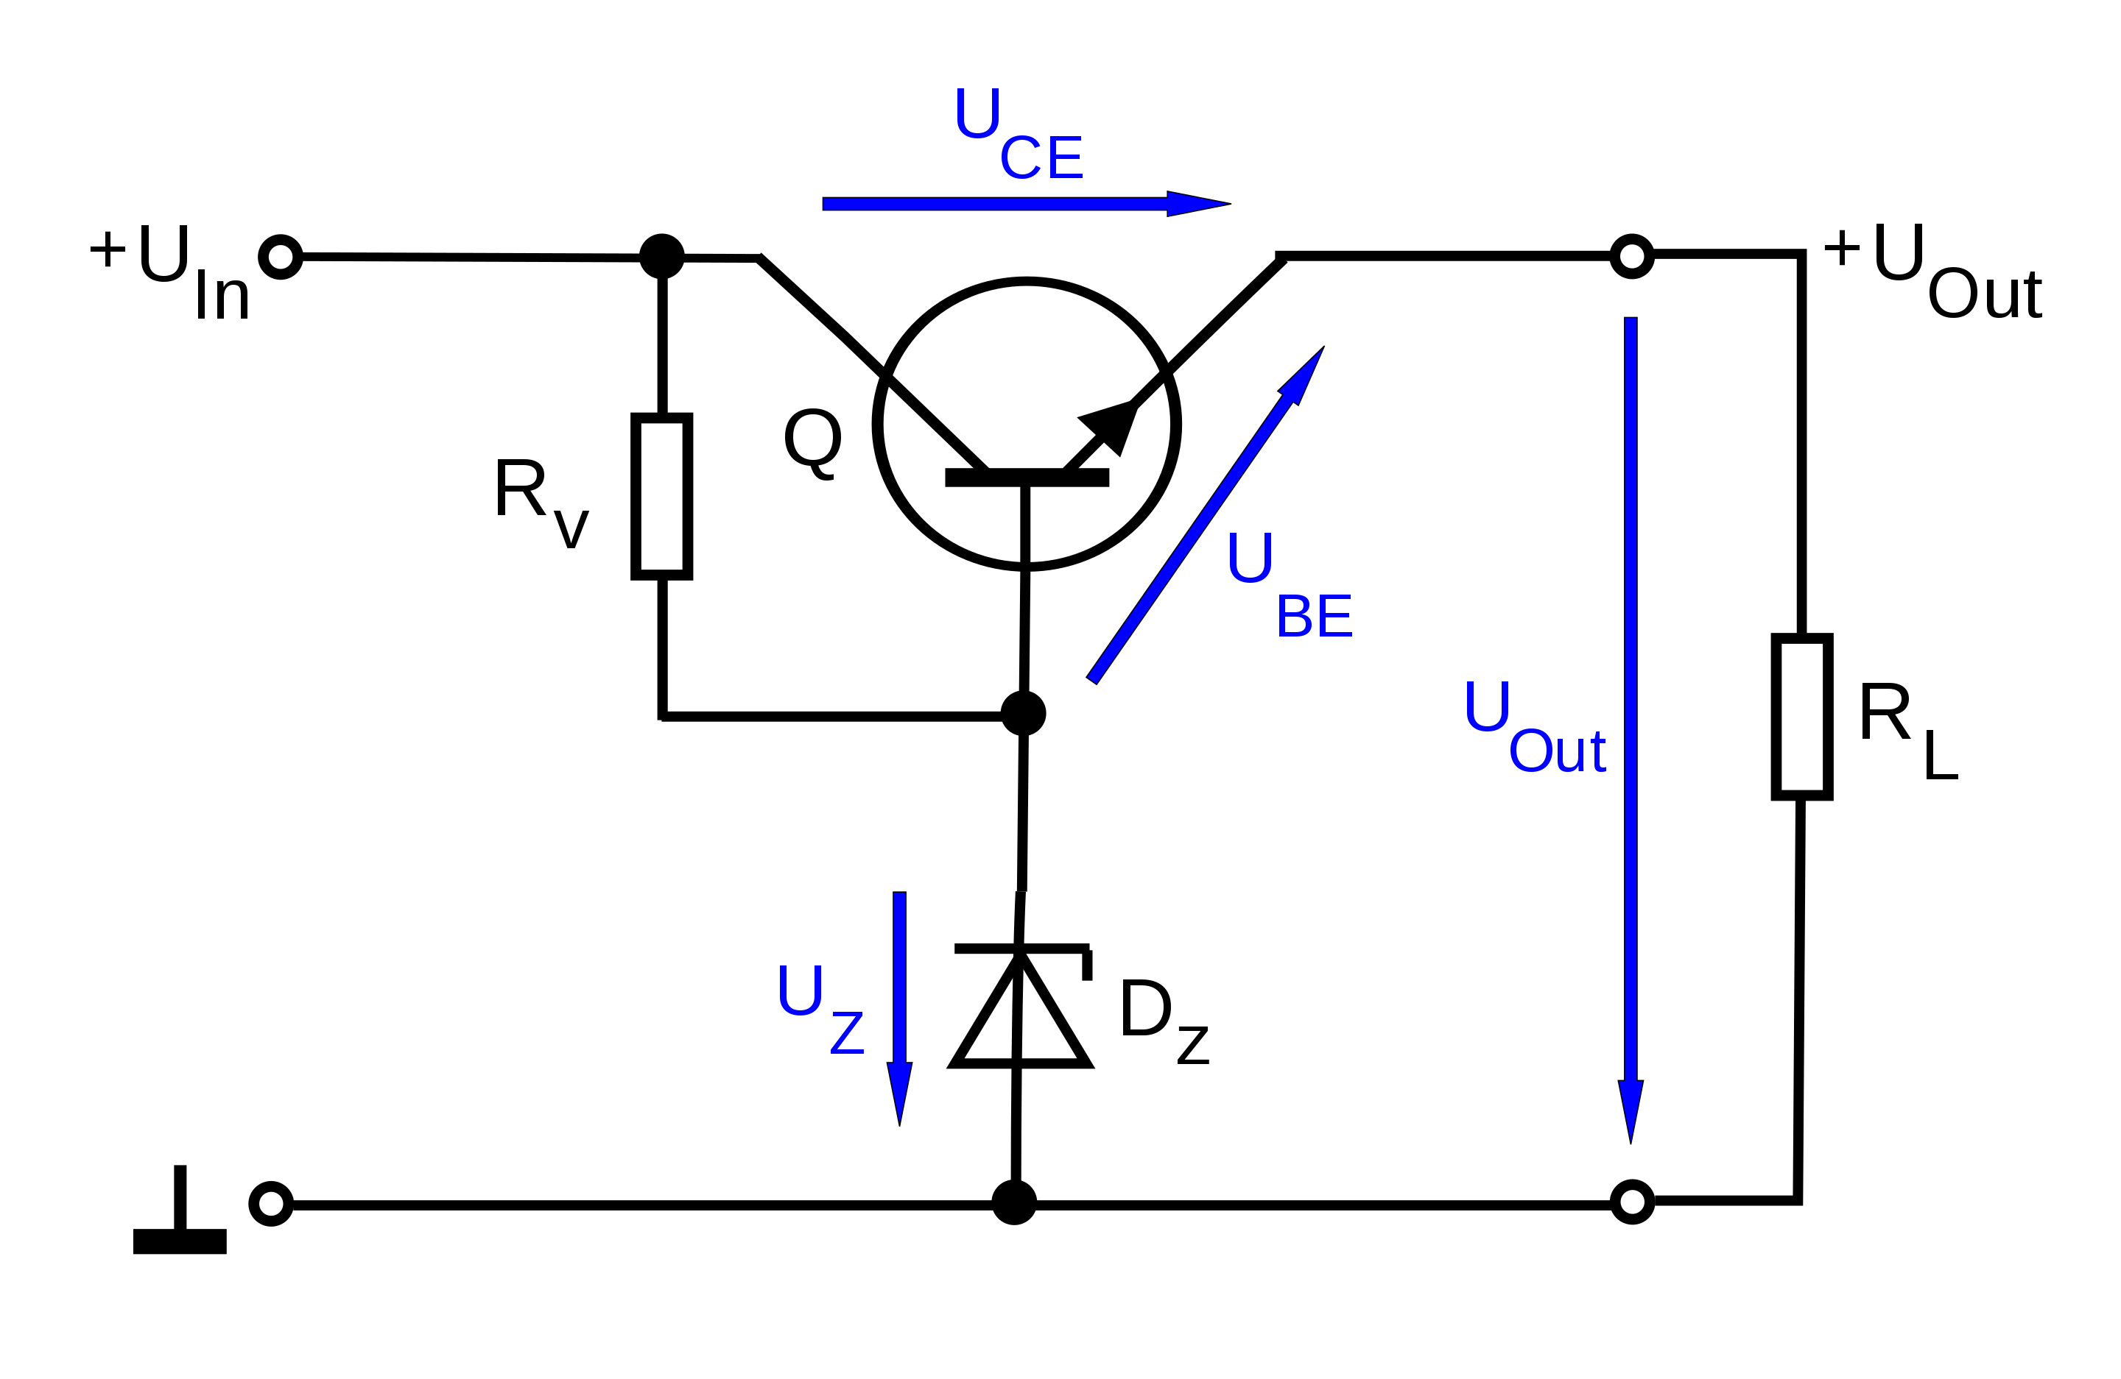
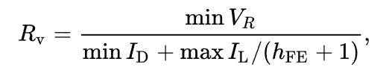


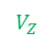
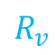
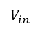

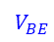
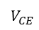

Parametric linear voltage regulator
$$V_{CE}$$
$$I_{L}$$
$$V_{in}$$
$$+V_{out}$$
$$R_{v}$$
$$V_{BE}$$
$$V_{out}$$
$$I_{d}$$
$$V_{Z}$$
where
min V_{R} is the minimum voltage to be maintained across R_{v},
min I_{D} is the minimum current to be maintained through the Zener diode,
max I_{L} is the maximum design load current,
h_{FE} is the forward current gain of the transistor (I_{C}/I_{B}).
Notes:
Adding an emitter follower stage to the simple shunt regulator forms a simple series voltage regulator and substantially improves the regulation of the circuit.
Here, the load current I_{L} is supplied by the transistor whose base is now connected to the Zener diode.
Thus, the transistor's base current (I_{B}) forms the load current for the Zener diode and is much smaller than the current through I_{L}.
This regulator is classified as "series" because the regulating element, the transistor, appears in series with the load.
R_{v} sets the Zener current (I_{Z}) and is determined as
R_{v}=(V_{in}-V_{Z})/( (KI_{Z}+I_{B}))=(V_{in}-V_{Z})/( (KI_{Z}+I_{L}/${(h}_{FE}+1)$))
Where
V_{Z} is the Zener voltage,
I_{B} is the transistor's base current,
K = 1.2 to 2 (to ensure that R_{v} is low enough for adequate I_{B})
I_{L} is the required load current and is also the transistor's emitter current (assumed to be equal to the collector current)
h_{FE}(min) is the minimum acceptable DC current gain for the transistor.
This circuit has much better regulation than the simple shunt regulator, since the base current of the transistor forms a very light load on the Zener, thereby minimizing variation in Zener voltage due to variation in the load. Note that the output voltage will always be about 0.65 V less than the Zener due to the transistor's V_{BE} drop. Although this circuit has good regulation, it is still sensitive to the load and supply variation. This can be resolved by incorporating negative feedback circuitry into it. This regulator is often used as a "pre-regulator" in more advanced series voltage regulator circuits.
The circuit is readily made adjustable by adding a potentiometer across the Zener, moving the transistor base connection from the top of the Zener to the pot wiper. It may be made step adjustable by switching in different Zeners. Finally, it is occasionally made microadjustable by adding a low value pot in series with the Zener; this allows a little voltage adjustment but degrades regulation (see also capacitance multiplier).

Slide 5

Parametric linear voltage regulator
$$V_{CE}$$
$$I_{L}$$
$$V_{in}$$
$$+V_{out}$$
$$R_{v}$$
$$V_{BE}$$
$$V_{out}$$
$$I_{d}$$
$$V_{Z}$$
where
min V_{R} is the minimum voltage to be maintained across R_{v},
min I_{D} is the minimum current to be maintained through the Zener diode,
max I_{L} is the maximum design load current,
h_{FE} is the forward current gain of the transistor (I_{C}/I_{B}).

Slide 6

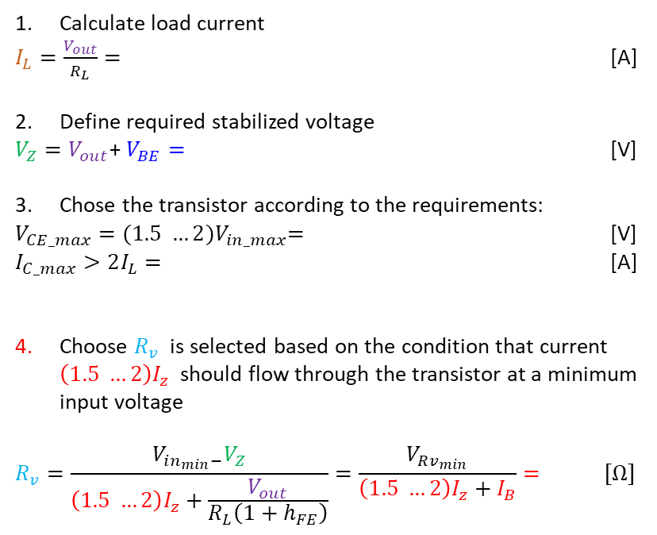
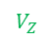
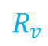
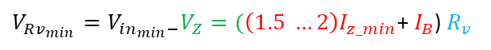
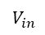

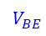

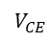

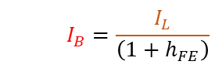
Parametric linear voltage regulator
Calculate load current
$I_{L}=\frac{V_{out}}{R_{L}}=$ [A]
Define required stabilized voltage
$V_{Z}=V_{out}$+ $V_{BE}=$ [V]
Chose the transistor according to the requirements:
$V_{CE_max}={(1.5 …2)V}_{in_max}=$ [V]
$I_{C_max}>2I_{L}=$ [A]
Choose $R_{v}$ is selected based on the condition that current $\left(1.5 …2\right)I_{z}$ should flow through the transistor at a minimum input voltage
$$R_{v}=\frac{V_{in_{min}−}V_{Z}}{\left(1.5 …2\right)I_{z}+\frac{V_{out}}{R_{L}\left(1+h_{FE}\right)}}=\frac{V_{Rv_{min}}}{\left(1.5 …2\right)I_{z}+I_{B}}= [Ω]$$
$$V_{CE}$$
$$I_{L}$$
$$V_{in}$$
$$+V_{out}$$
$$R_{v}$$
$$V_{BE}$$
$$V_{out}$$
$$\left(1.5 …2\right) I_{z_min}$$
$$V_{Z}$$
$$I_{d_min}= \left(1.5 …2\right)I_{z_min}$$
$V_{Rv_{min}}=V_{in_{min}−}V_{Z}=(\left(1.5 …2\right)I_{z_min}$+ $I_{B}$) $R_{v}$
$$I_{B}=\frac{I_{L}}{\left(1+h_{FE}\right)}$$

Slide 7

TEST 1
https://forms.yandex.com/cloud/6363408243f74f24464db4b5/
https://clck.ru/32Zfm6
1st deadline: 04.11.2022 15:15 (GMT +8)

Slide 8
Thank you for your attention!

